Slide 1

Web application review

Slide 2
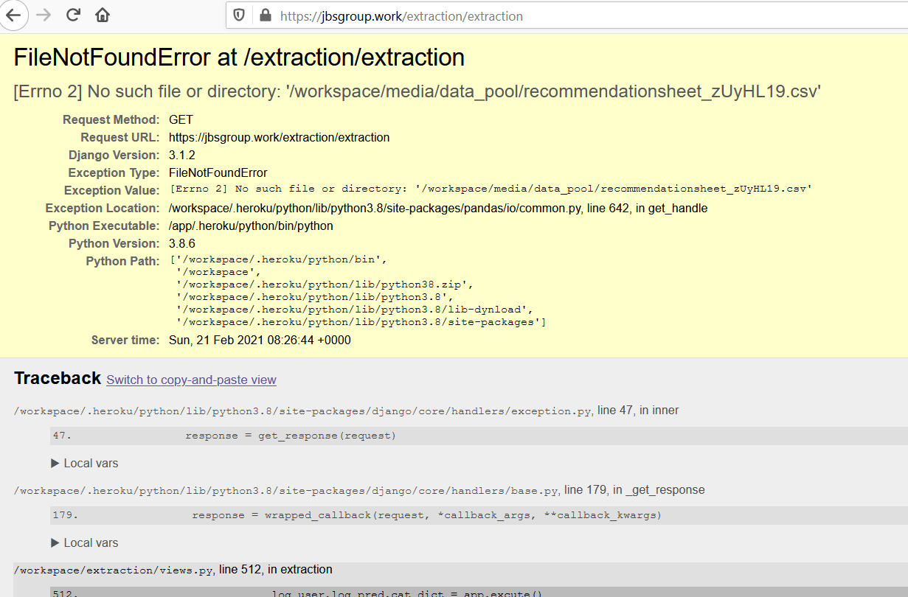
The extraction page has some errors

Slide 3
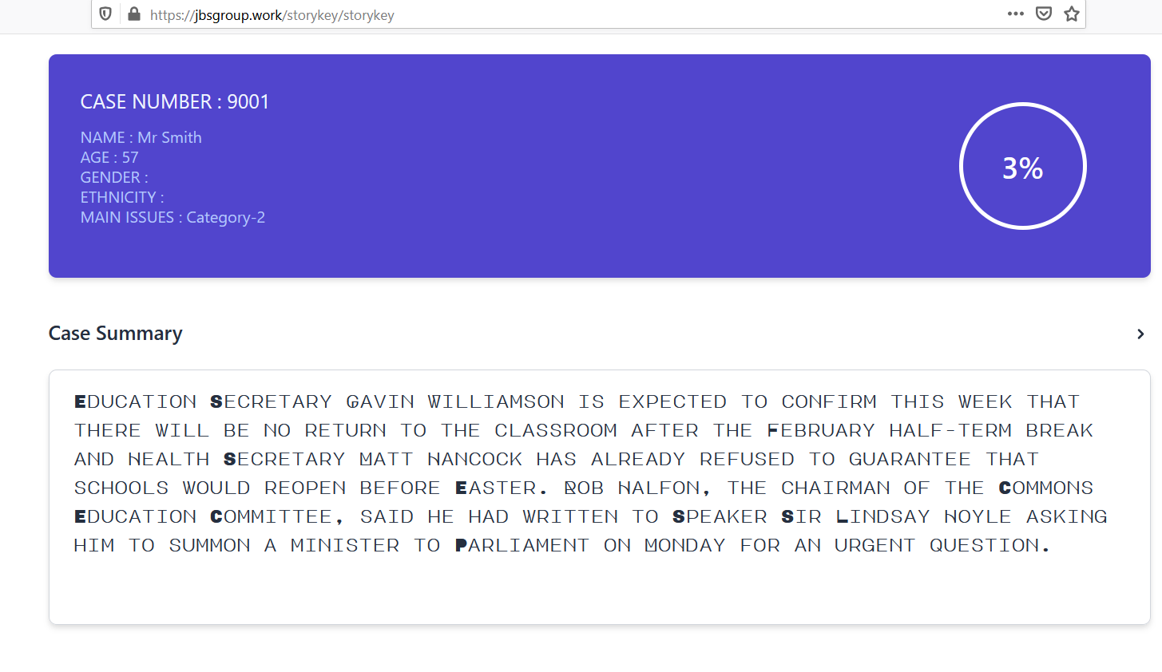
The appearance line by line can be change to appear all-in-one

Slide 4
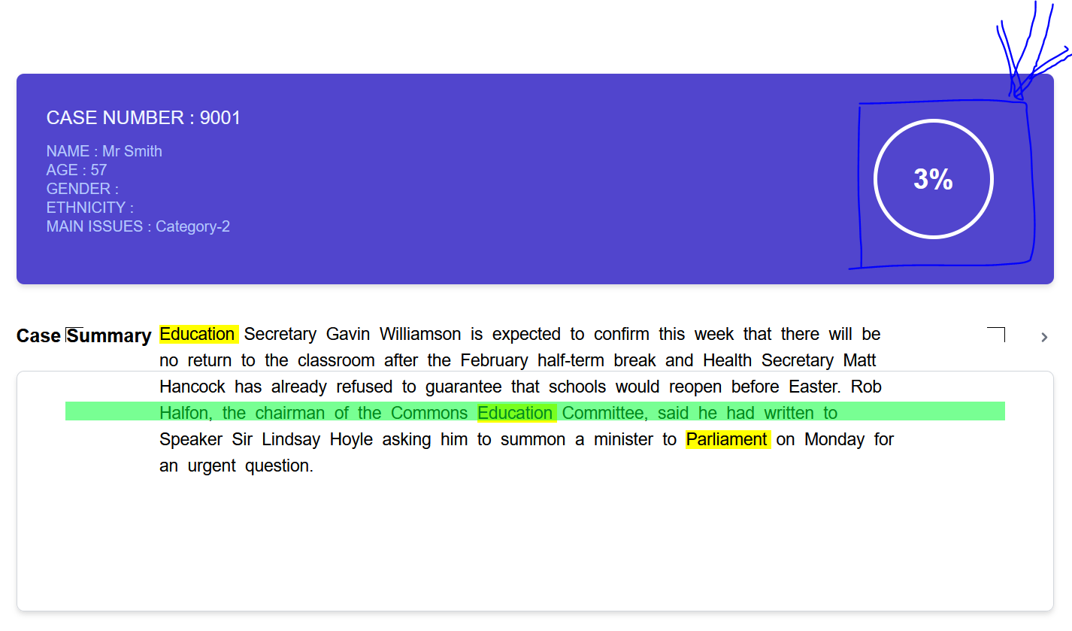
The cancer risk assessment score should appear only at later stage when the user data input is complete.

Slide 5
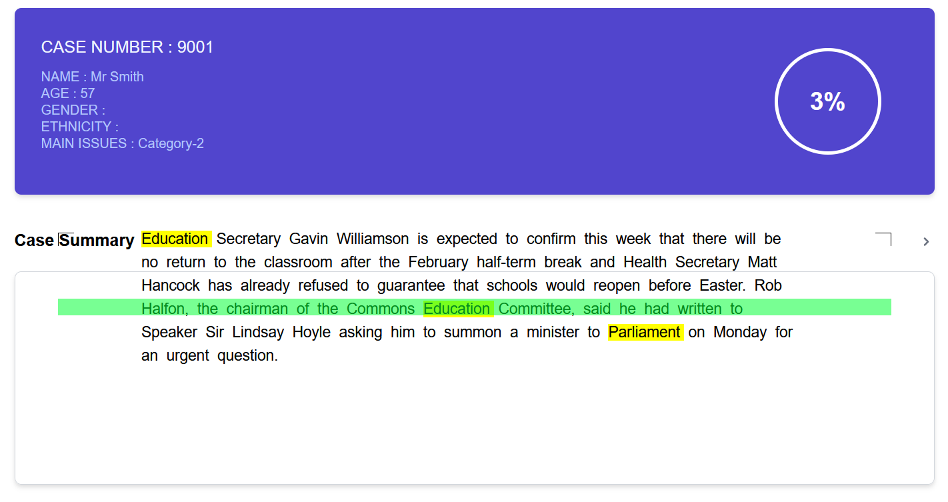
There are a few issues with this page – Please see the next page for detailed descriptions

Slide 6
What are the issues with this UI?
The text is not centrally placed within the placeholder.
Part of the text is outside the placeholder
The scanning is taking place somewhere outside
What happens when the text matter is too big or too small?
Is the placeholder expandable?

Slide 7
UI Suggestions
Expandable text placeholder which holds the text centrally
Scanning involving the placeholder.
If scanning bar looks awkward, I have the following suggestions.
The green selection blocks which highlights the block of text is quite useful.

Slide 8
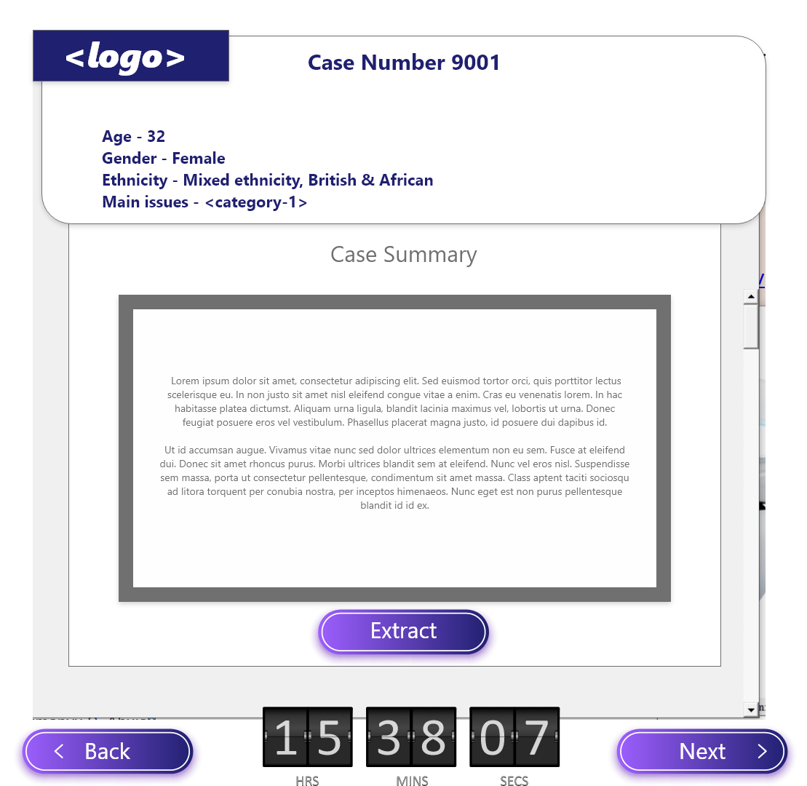
Pre-extraction screen

Slide 9
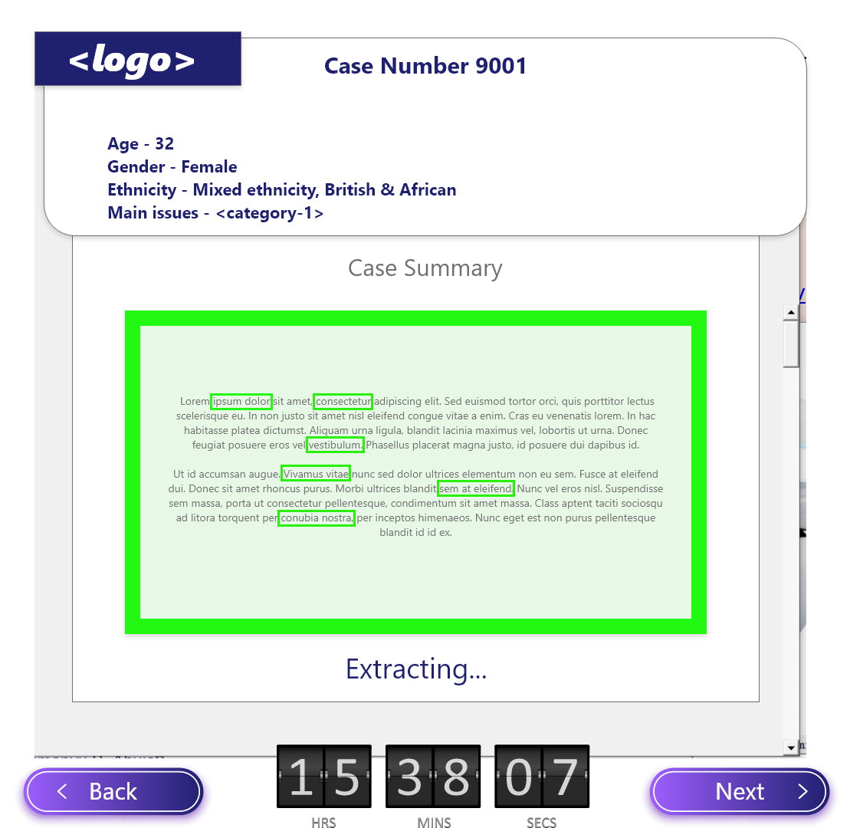
Extraction screen

Slide 10
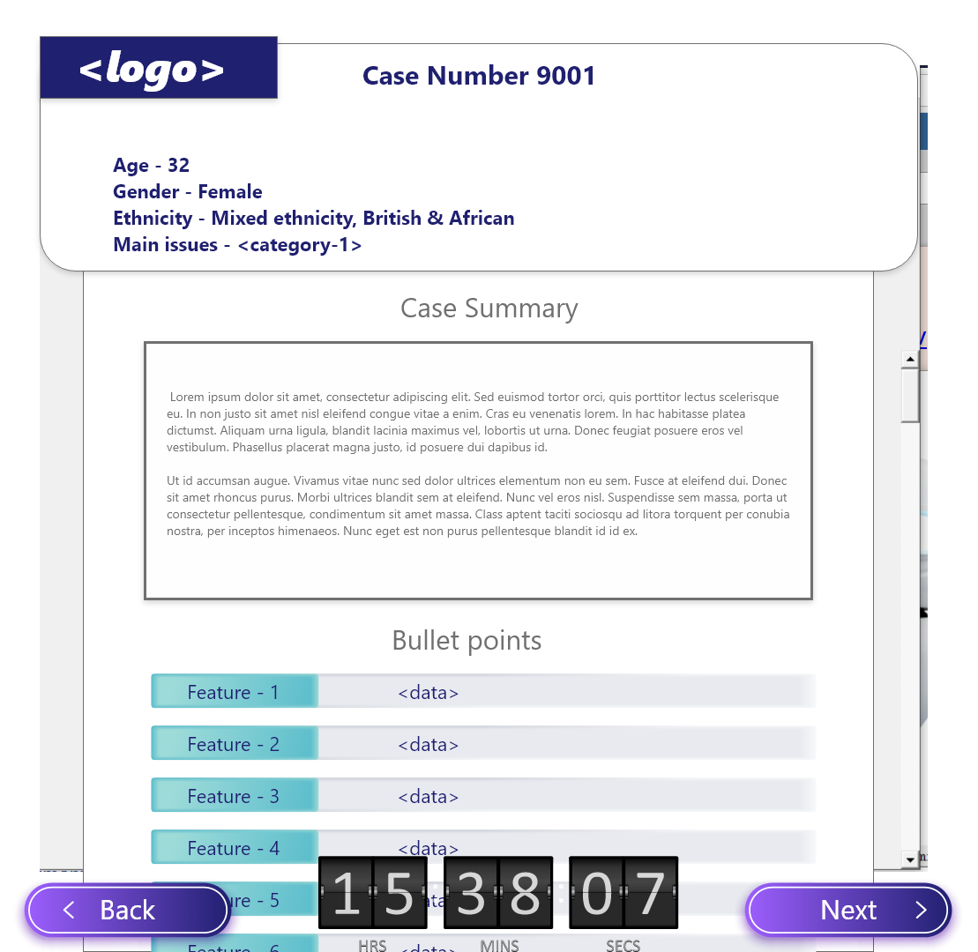
Post-extraction screen

